Slide 1

Working with QtQuick and Python on a real-life Robotics Project

Slide 2
Overview
From C++ to Python
Project Structure & Workflow
Quality Assurance & Issues
Conclusion

Slide 3
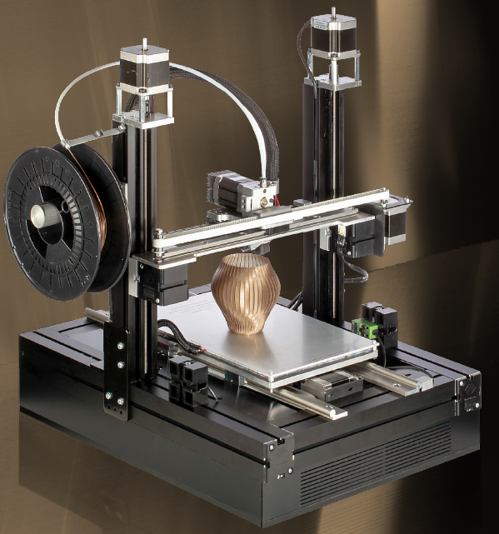

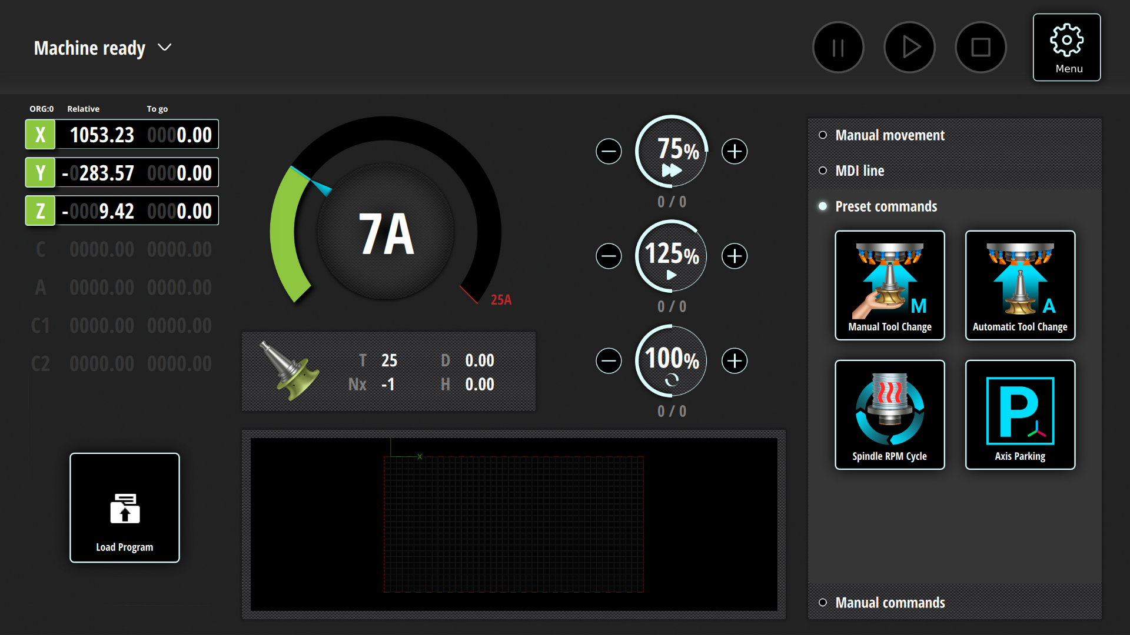
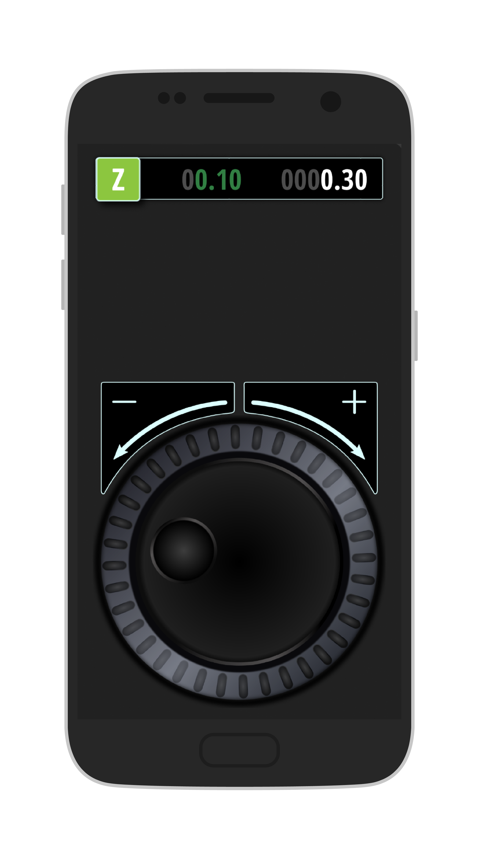
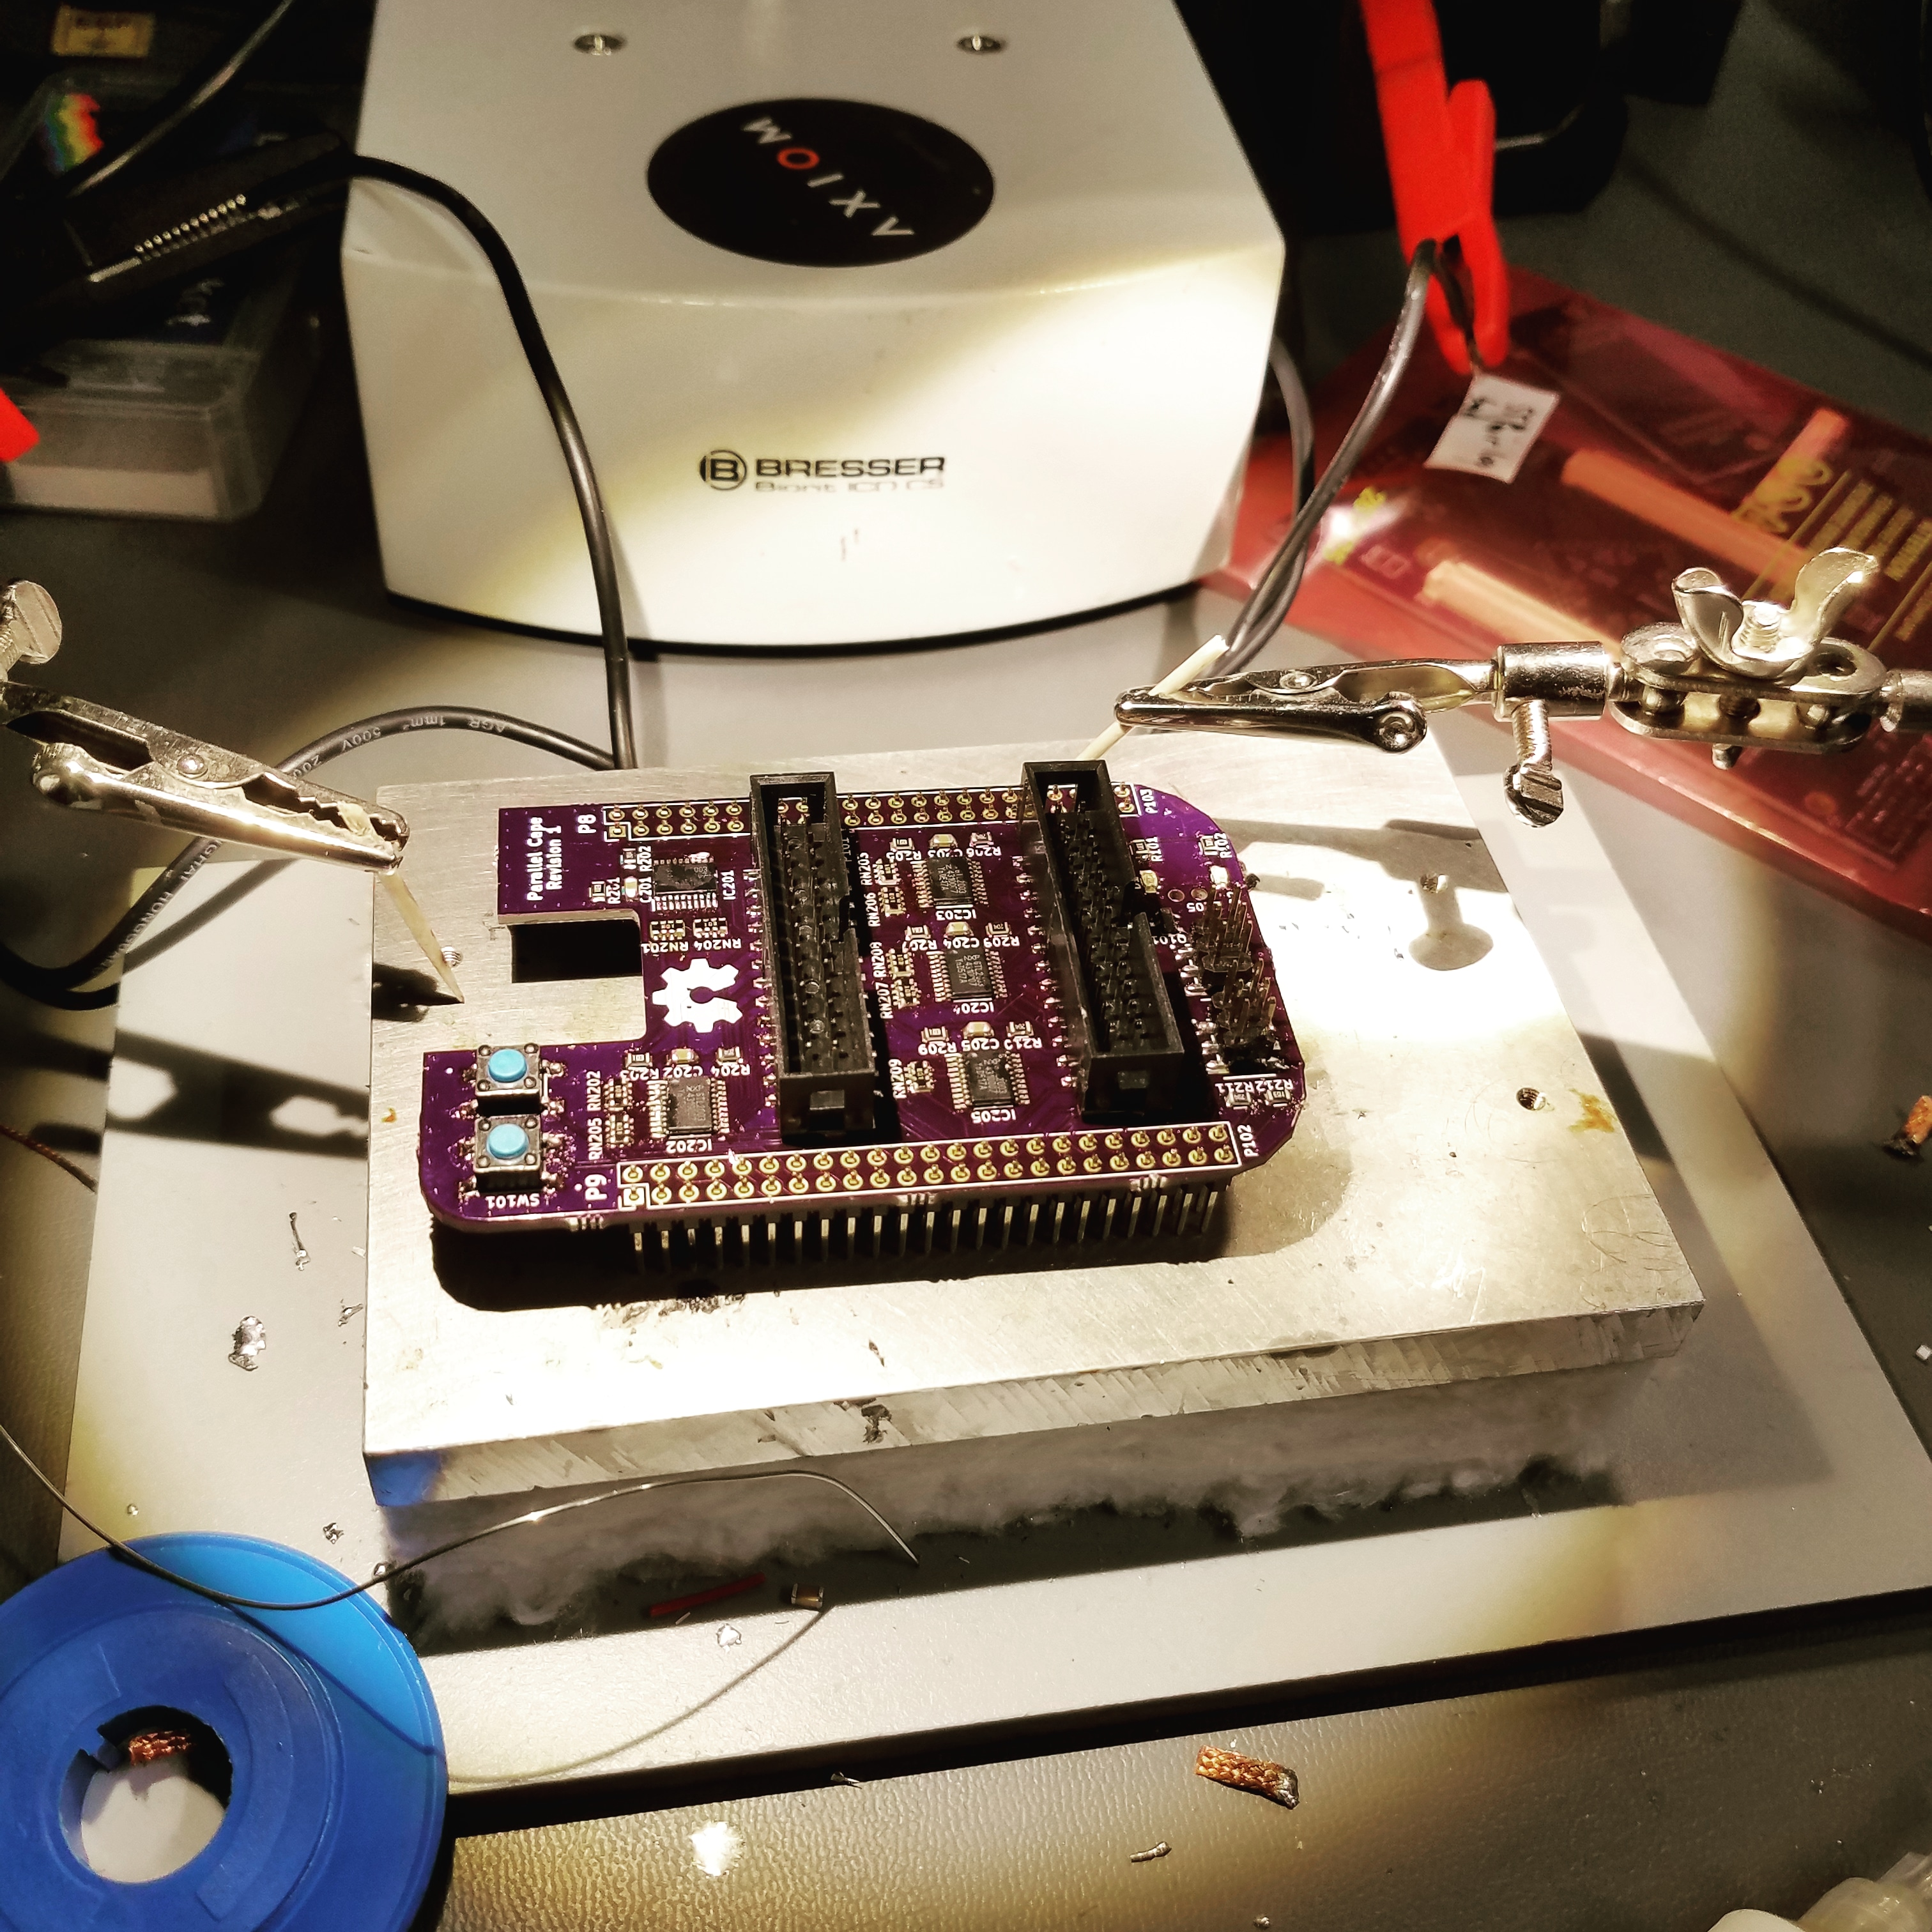
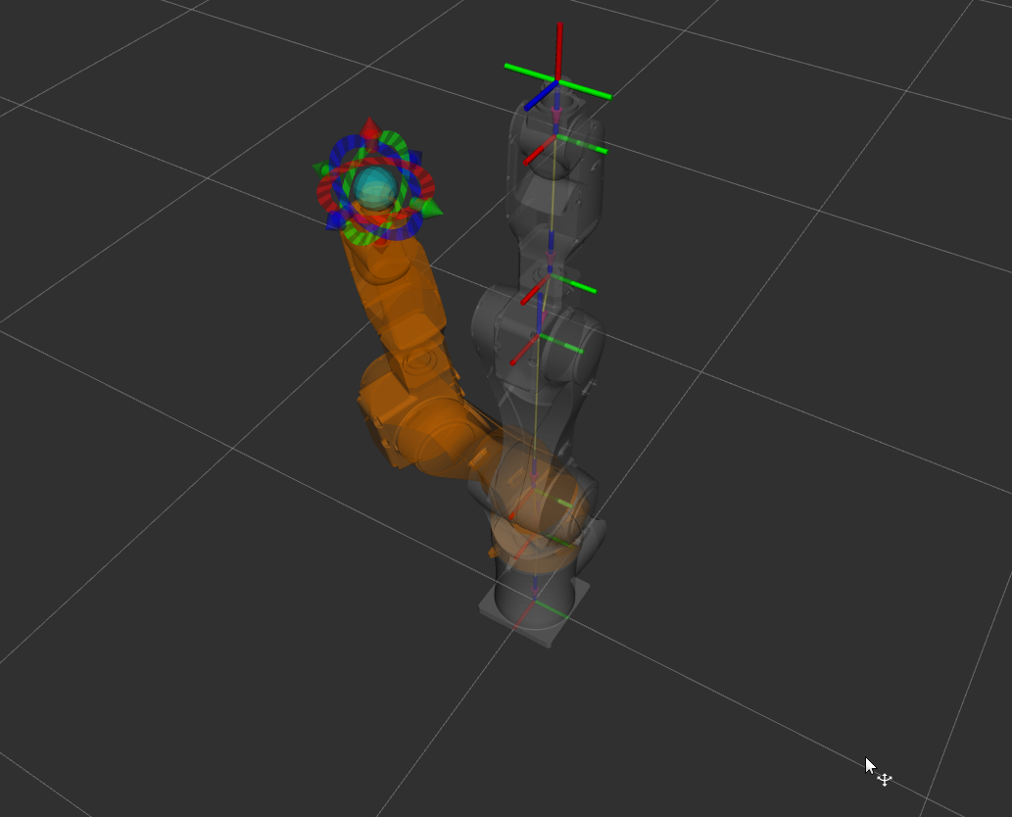
About Me
Alexander Rössler
Embedded Systems
All things Open Source
3D printing, CNC, robots, …
“Solopreneur”

Slide 4
From C++ to Python

Slide 5
From C++ to Python
> 10 years C++ and Qt
5-6 years ago Python
2013 PyQt5 – discarded
2018 tried again
Success!

Slide 6







A long long time ago...
> 10 years
Delphi → C++ and Qt

Slide 7

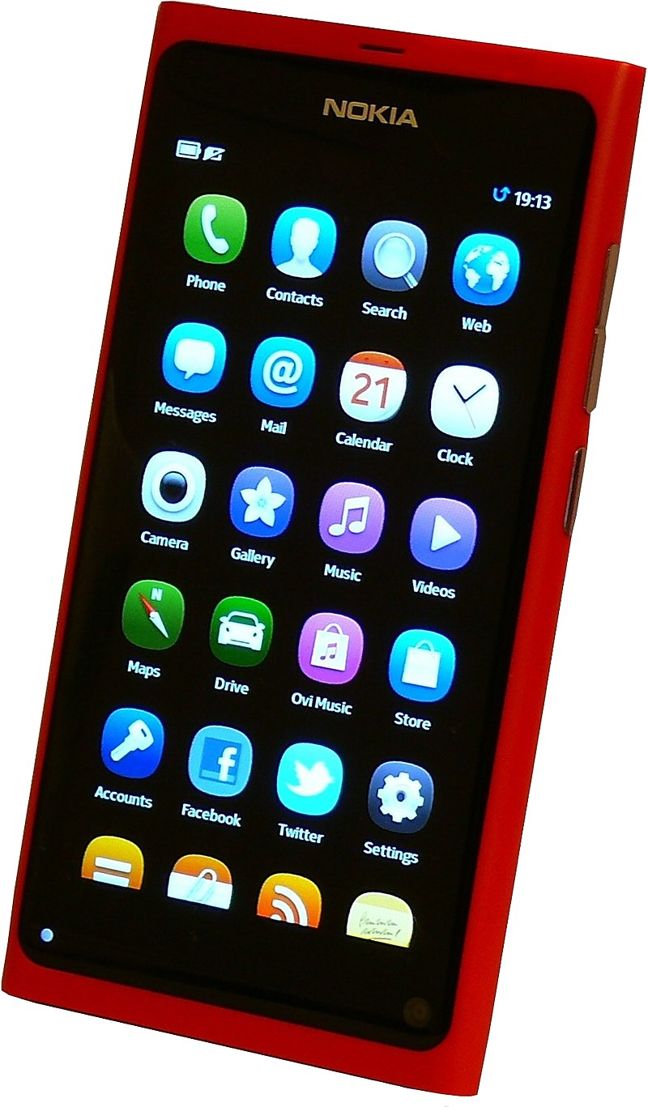
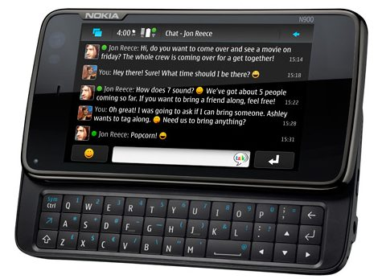

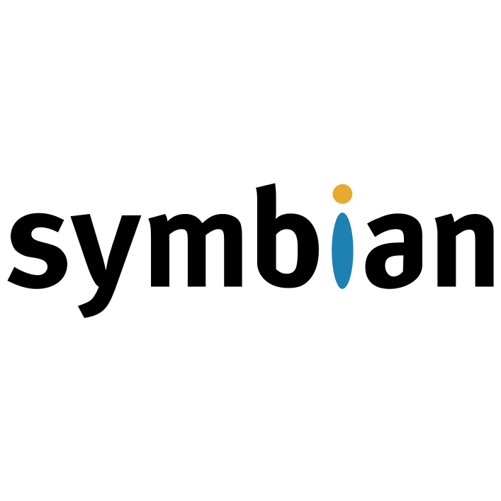
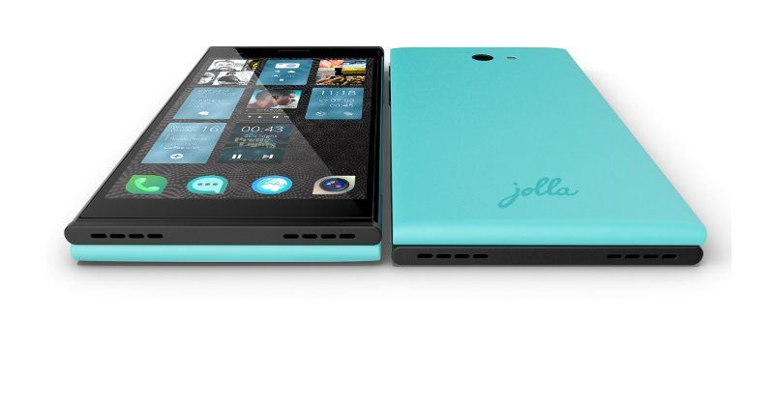

Slide 8
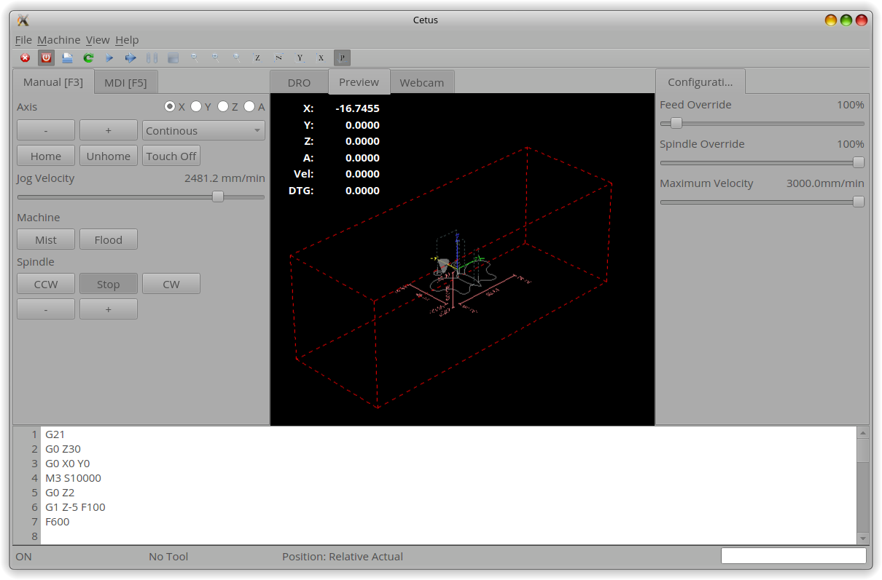
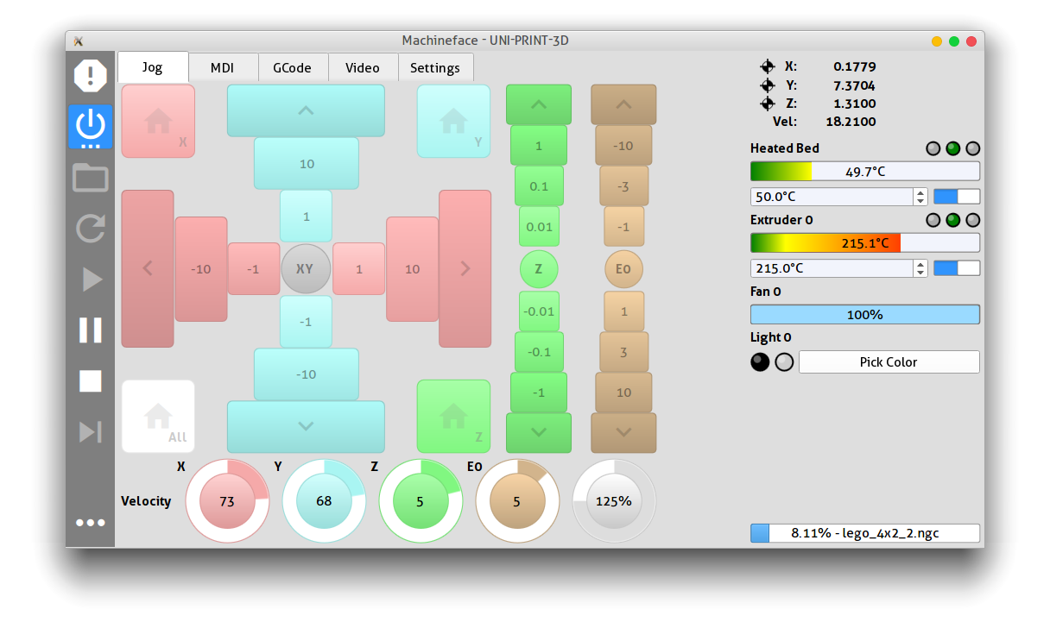



Open Source
Machinekit
New UI → QtQuickVcp
Cross-platform

Slide 9


Objections
Not scale-able
Slow
Not safe
Prototyping only
No mobile OS

Slide 10
CNC & 3D Printing
TheCoolTool
PMC Stone
Tormach
...

Slide 11
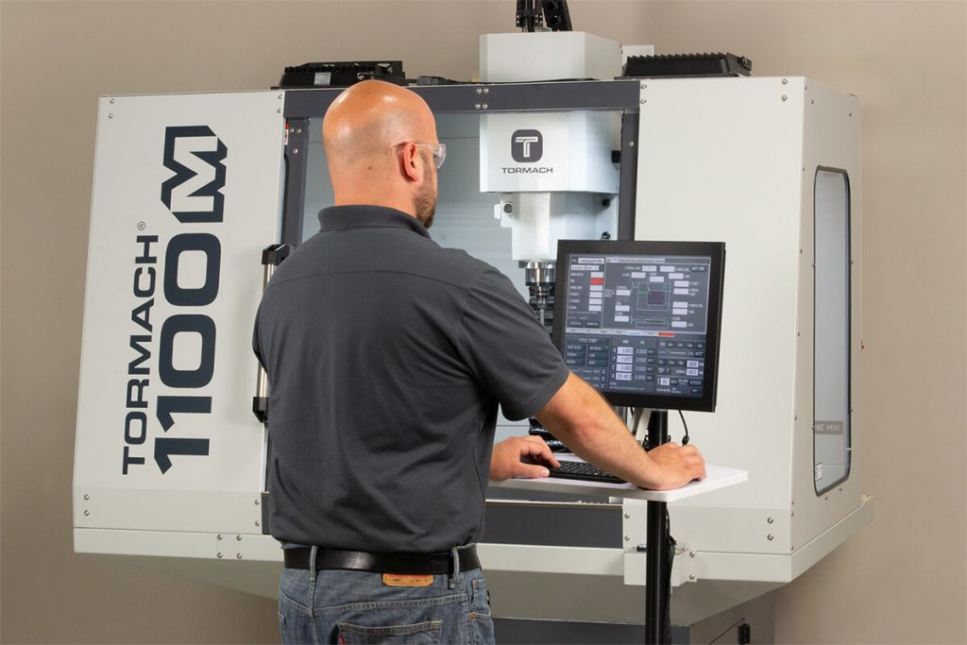
Tormach
Affordable CNC
PathPilot
User Friendly

Slide 12
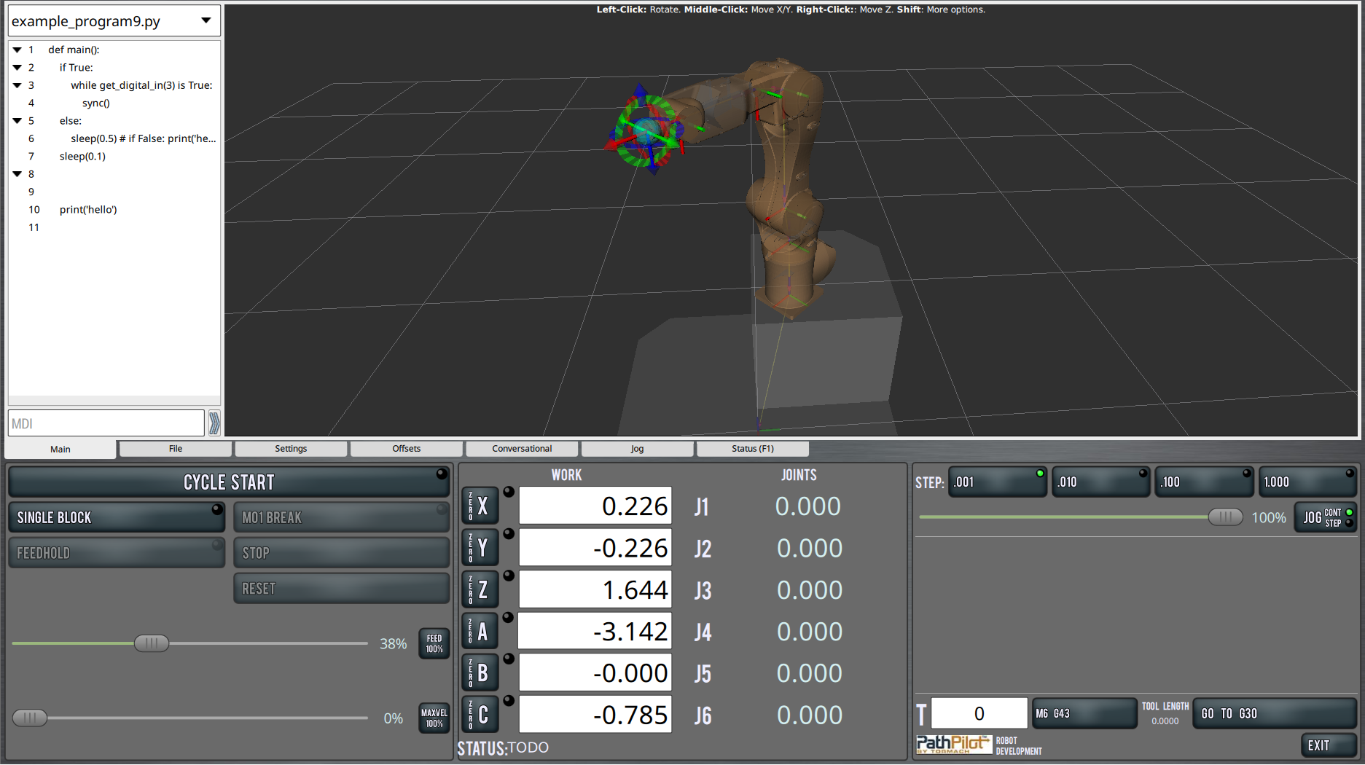
Robot Project
Python widely used
Gtk2 → ?
ROS, rospy
Rviz

Slide 13

Qt & Python
+ 👍

Slide 14
Reasons
 | Qt/Python | Qt/C++
LOC | 1x | 2-3x
Development Speed | 3-5x | 1x
Popularity | 3. | 5.
Cross-platform | Desktop +, Mobile - | All++
QA | Duck-typing, interpreted, .. | Static-typing, compiled, memory, ...
Testing | Duck-typing, no recompile, TDD | Static-typing, templates, compiled
Performance | Slow | Very fast
Features/Bugs | Qt/C++ and wrapper, few users | Qt/C++, many users

Slide 15
PyQt or Qt for Python?
 | PyQt | Qt for Python
License | GPLv3 or Riverbank Commercial | LGPLv3 or Qt Commercial License
API Completeness | ~ | ~
Tools and Add-ons | pyqtdeploy, QScintilla, Sip | ...
Community | PyQt, longer history | Qt project, relatively new
Support | 500$ commercial | Qt commercial support
Binding Generator | sip | shiboken

Slide 16
PyQt or Qt for Python?
Wrapper
python_qt_binding
QtPy
…

Slide 17
Project Structure
& Workflow

Slide 18
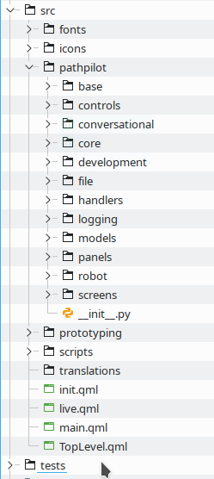
Project Structure
init/main.qml → production
live.qml → live coding
main.py → scripts

Slide 19
Project Structure
init/main.qml → production
live.qml → live coding
main.py → scripts

Slide 20
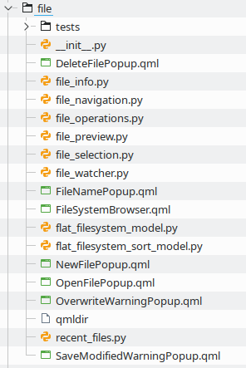
Mixed QML Modules
QML and Python
QML modules
C++ → external
Binding

Slide 21
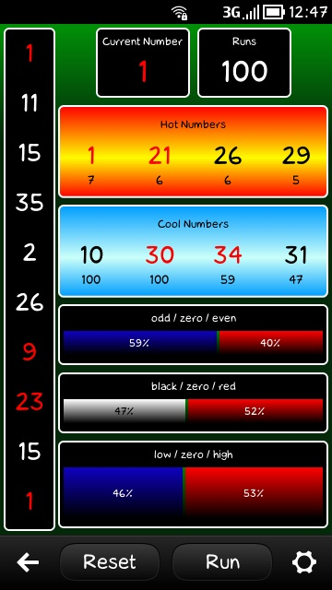

Scaling Up QML
Small app → straightforward
Complex HMI → ???
QtCon 2016
Neptune 3

Slide 22
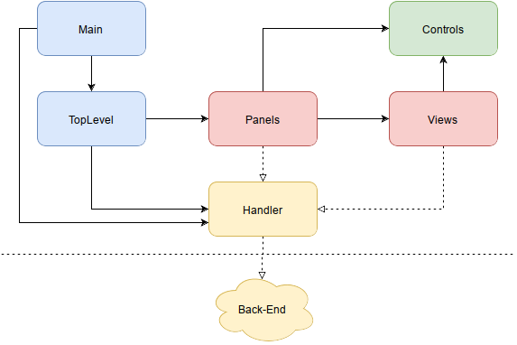
QML Architecture
Scaling up
~Neptune 3

Slide 23
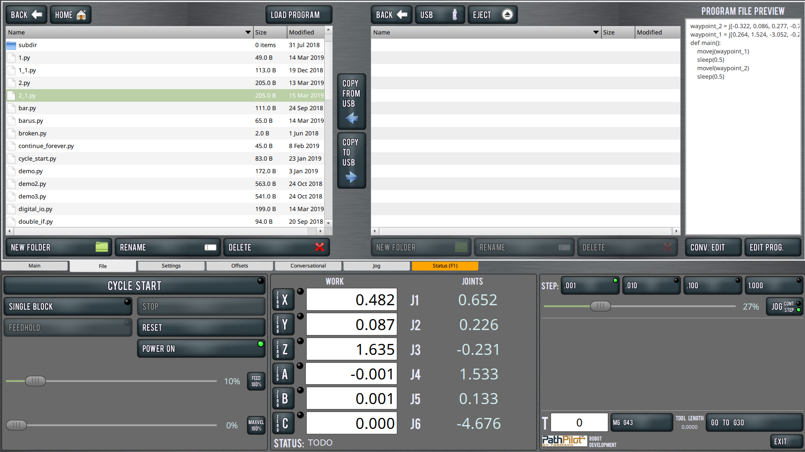
Handlers

Slide 24
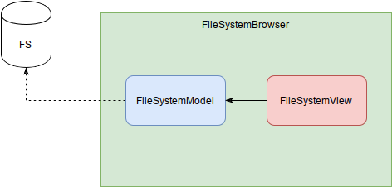
Handlers
Good for single use
Dialogs
Popups
…

Slide 25
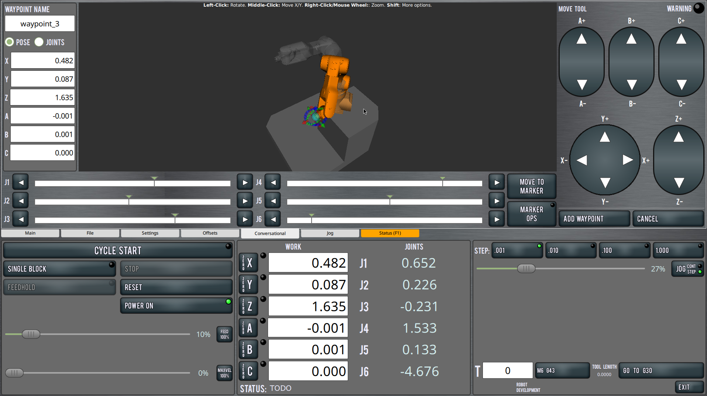
Handlers

Slide 26
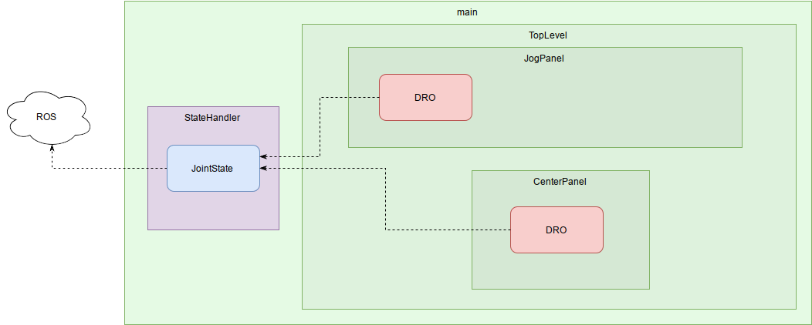
Handlers
Access via reference
Consistent state

Slide 27
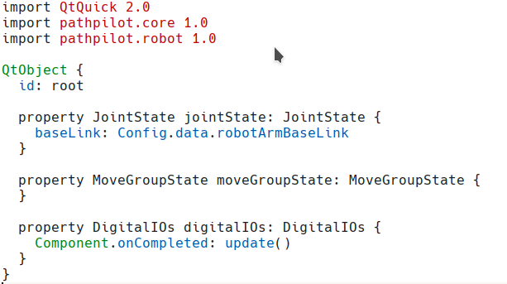
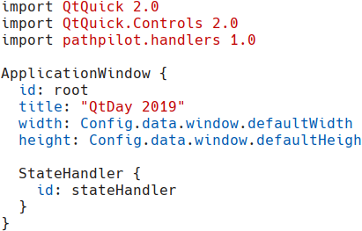
Handler Instantiation

Slide 28
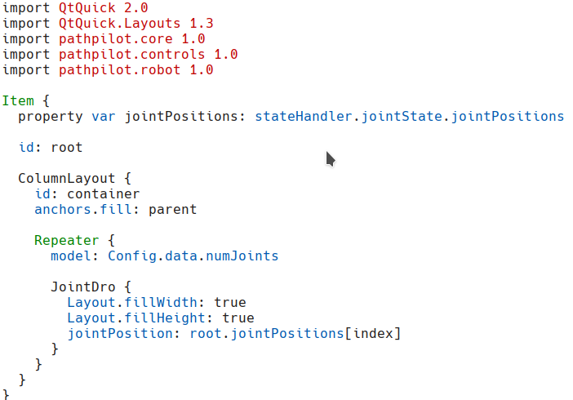
Handler Usage

Slide 29
Other Difficulties
Config singletons
Global Object
Scalable UI
Scalable popups and fold-outs
Calling generic JS function from Python

Slide 30
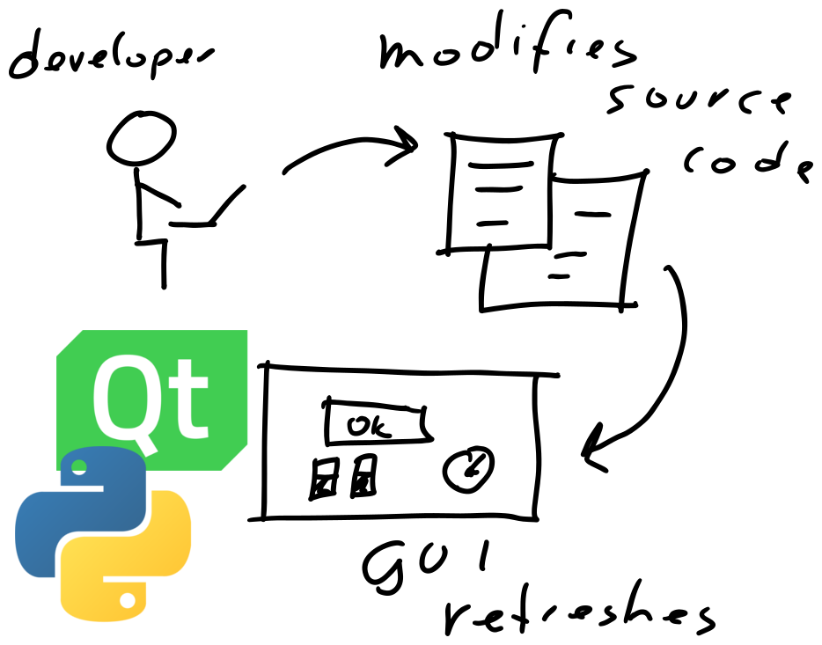
Working with QtQuick & Python
Live coding
Short feedback loops

Slide 31



Working with QtQuick & Python
Code editor
  QtCreator → PyCharm → CLion
QML support
Python tests

Slide 32
Working with QtQuick & Python
Code editor
  QtCreator → PyCharm → CLion
 | QtCreator | CLion
C++ | ++ | ++
Python | - | ++
Performance | ++ | +
QMake | Yes | No
Price | Free | 199€ – 159€ – 119€
Open Source | Yes | No
QML | ++ | -
CMake | + | ++

Slide 33
Quality Assurance
& Issues

Slide 34
QA Overview
Clean Code
Static analysis
Testing
Debugging
Problems

Slide 35



Tools
Black
qmlfmt
Flake8
Pre-commit
Docker

Slide 36
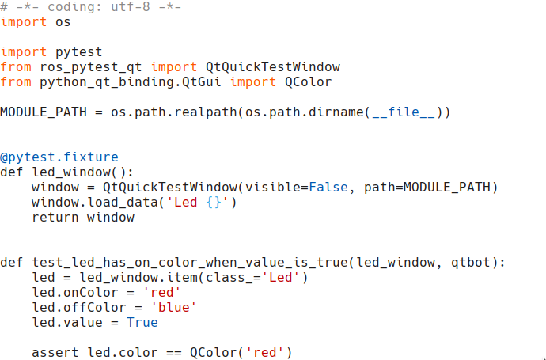

Testing
TDD
Pytest
pytest-qt

Slide 37
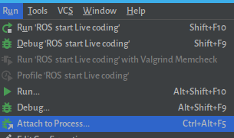
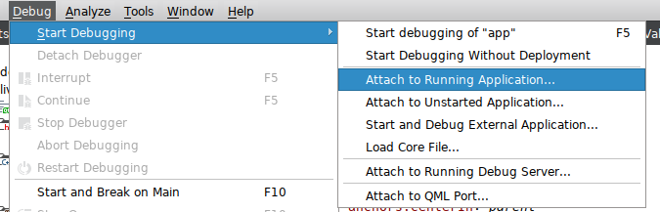
Mixed Debugging
Qt Creator or CLion
Attach to Running Application
Logging

Slide 38

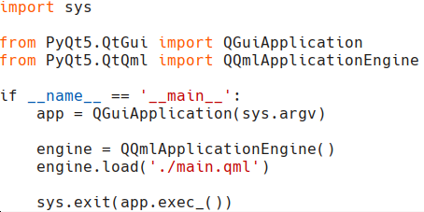
Qt Event-Loop
Ctrl-C

Slide 39
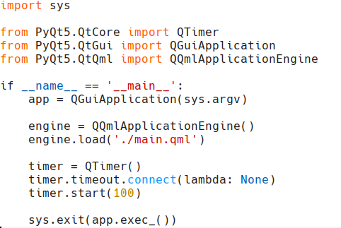
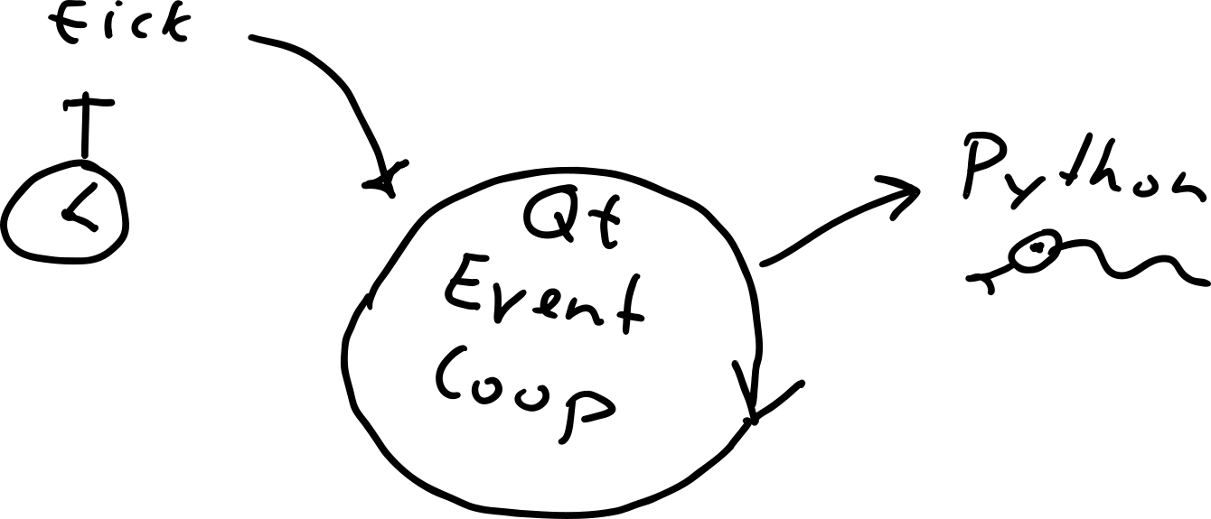
Qt Event-Loop
Ctrl-C

Slide 40
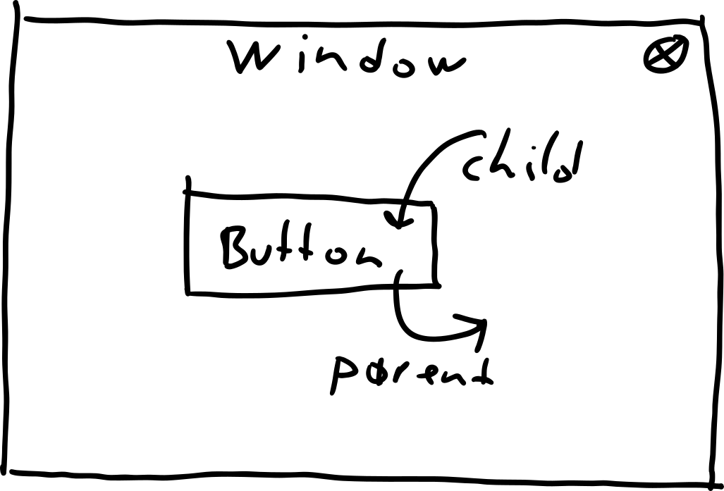
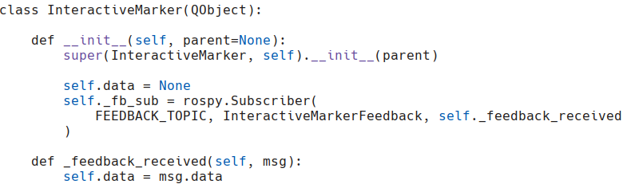
Long-Living Objects
Python object
QML component
Global reference

Slide 41
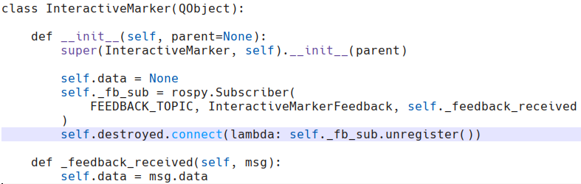
Long-Living Objects
Python object
QML component
Global reference

Slide 42
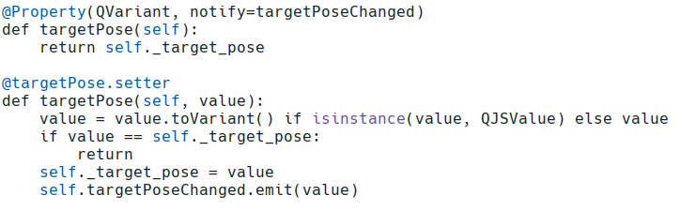


QVariant Property
QJSValue
List

Slide 43
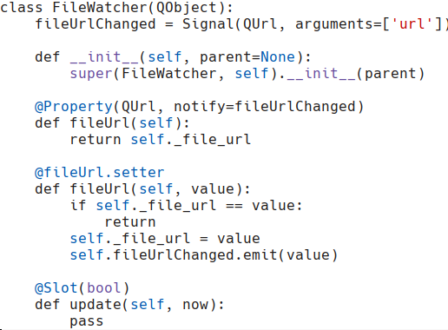
Boilerplate & Case
Boilerplate code
snake_case or
camelCase

Slide 44
Other Problems
QML type limit: 60
PySide2: qmlRegisterSingletonType
PyQt: QValidator and QQuickItem
Boilerplate code
CamelCase vs snake_case

Slide 45
Conclusion

Slide 46
Conclusion
Try Qt for Python
Use C++ where necessary

Slide 47
Questions?

Slide 48

More Information
https://machinekoder.com
https://github.com/machinekoder
Questions ?

